Slide 1
Asynchronous Programming
Module 14

Slide 2
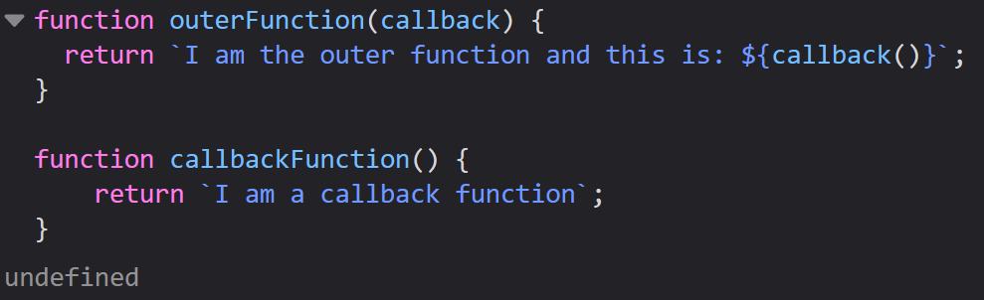


Callback Functions
A callback function is a function passed as an argument to another function
This allows one function to call another function
The callback function can run after another function has finished

Slide 3
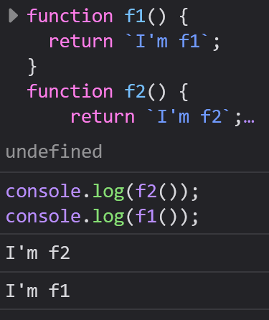

Function Sequence
JS functions are hoisted, meaning they will be treated like they were declared at the top of their scope.
Functions execute in the order they are called, not the order they were defined in

Slide 4
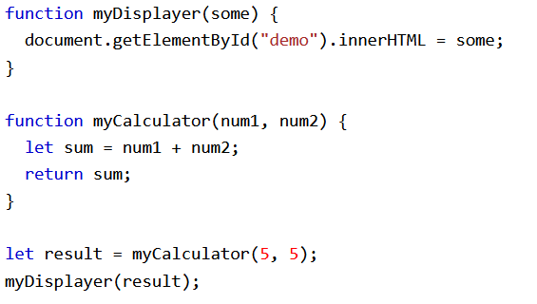


Sequence Control
Sometimes you want to have better control over when you execute a function
You could save the result of myCalculator and display the result

Slide 5
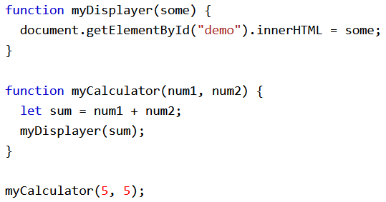
Sequence Control
Or you could call myCalculator and let myCalculator call the myDisplayer

Slide 6
Sequence Control
Each example has a problem with it
The first example requires you to call two different functions to display the result
The second example can’t prevent the calculator function from displaying the result

Slide 7
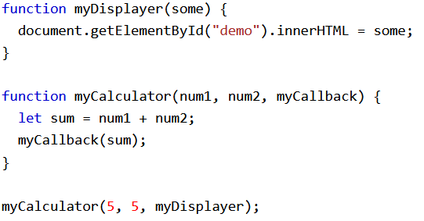
JS Callbacks
You could call myCalculator with a callback and let myCalculator run the callback after the calculation is finished.
When you use a callback function, you can choose exactly when both results are executed

Slide 8
When to Use Callbacks
Callbacks are best for use in Asynchronous functions, where one function must wait for another function to complete execution to begin its own execution

Slide 9
Asynchronous JavaScript

Slide 10

Asynchronous Functions
Asynchronous Functions run in parallel with other functions
Examples:
setTimeout()
setInterval()

Slide 11
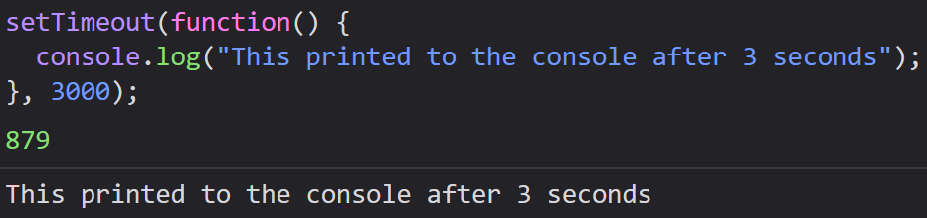
Waiting for Timeout
setTimeout() allows you to make a callback function execute after a specified amount of time
It takes a callback function to execute after the timeout, and a specified number of milliseconds to wait to execute

Slide 12
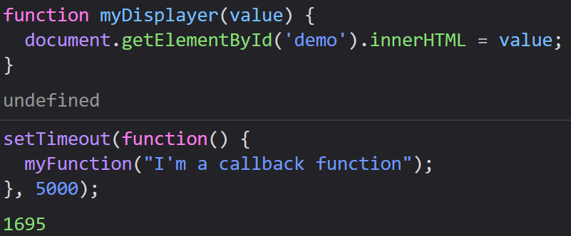
Waiting for Timeout
You can pass it a callback function definition (like below), you can write an anonymous function, or you can write an arrow function

Slide 13
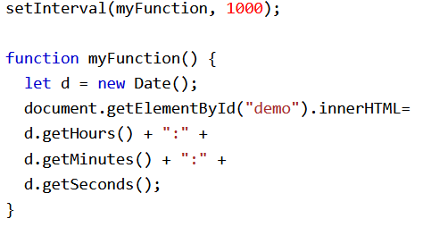
Waiting for Intervals
setInterval() allows you to specify a callback function to be executed for each interval (every number of milliseconds)
myFunction is a function displaying the date as HH:MM:SS
It will be executed every 1000 milliseconds (1 second)

Slide 14
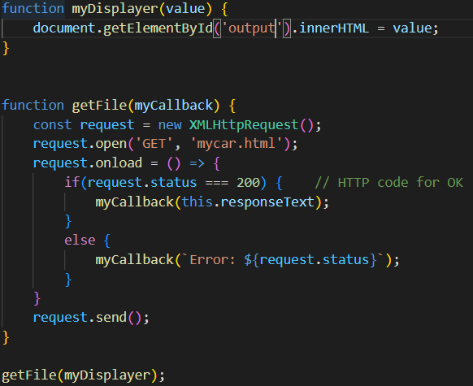
Waiting for Files
If you create a function to load an external resource (like a script or file), you can’t use it before it’s fully loaded

Slide 15
Promises

Slide 16
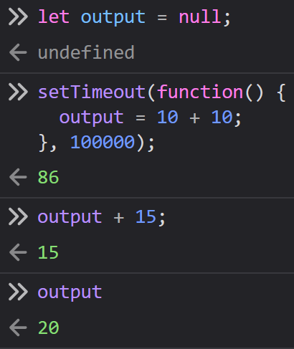
Promises
A promise is an object that links “Producing code” with “Consuming code”
Producing code: code that will take a while to complete
Consuming code: code that depends on the result of the consuming code to run
We can run into trouble if we use the producing code before it is ready to be used

Slide 17
Promise Objects
Promise Objects contain both the producing code and calls to the consuming code
When the executing code obtains the result, it should call one of two callbacks:
Promise Objects contain both the producing code and calls to the consuming code
When the executing code obtains the result, it should call one of two callbacks:
myResolve(result value) – Success
myReject(error object) - Error

Slide 18
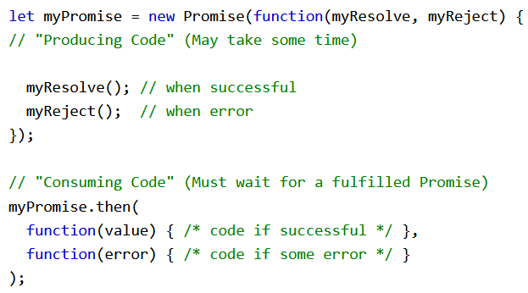
Promise Syntax

Slide 19
Promise Object Properties
Promise Objects have 2 properties:
state – Can have any of three values depending on the execution
result - Output of the promise if successful
A Promise only has a value for result if the promise is successful
state and result are private variables and can only be accessed using Promise methods

Slide 20

Promise Object Properties
Promise Object’s state can have three values:
Pending – The promise is still ‘working’, so the result is undefined
Fulfilled – The promise was successful, so the result is a value
Rejected – The promise was unsuccessful, so the result is an Error

Slide 21
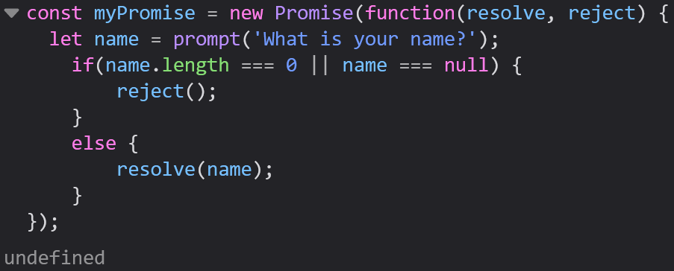
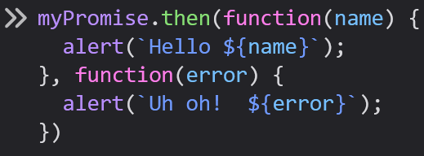
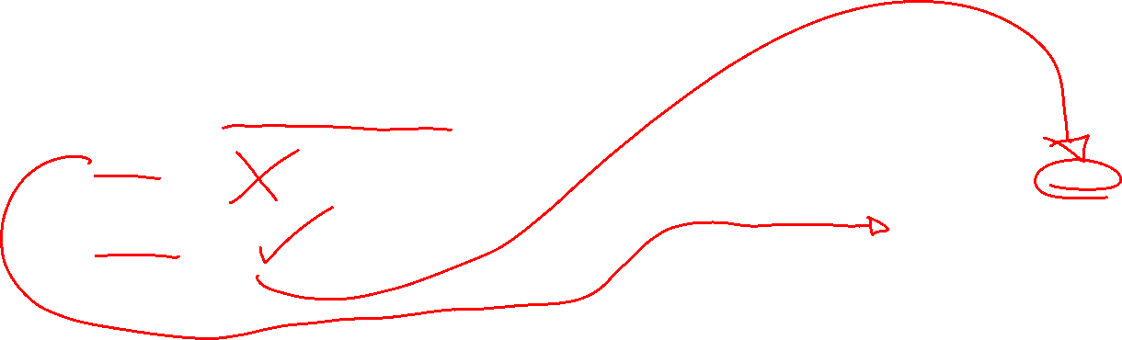
Promise Example
This Promise will ask the user for their name
This will send an alert if they enter a valid name saying Hello

Slide 22
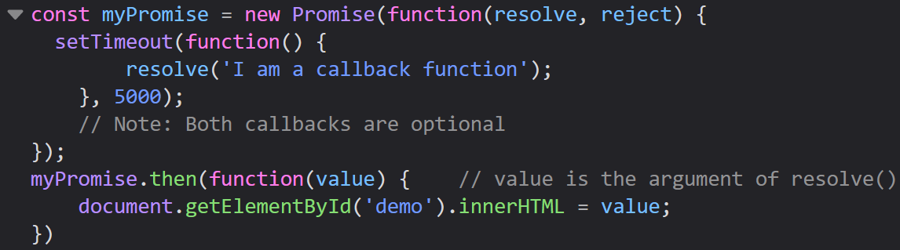
Waiting for a Timeout: Callback vs Promise
Callback
Promise

Slide 23
.then()
Used to call one of two optional callback functions, one for success and one for failure.
Both callback functions are optional and many times .then() only uses a success function
Only one of the two callback functions, success or failure, will execute depending on whether an error occurred or not

Slide 24
.then()
then() is especially useful for situations where we wrote our code perfectly, but something could still cause it to fail
This could result from a server being down, a file being deleted, or a bad internet connection
Situations like these are where the reject (failure) case comes in

Slide 25
Async/Await

Slide 26
Async/Await
async: makes a function return a promise
await: makes a function wait for a promise to resolve
These keywords are exclusively used together and make our Promises easier to write

Slide 27


Async Syntax
The async keyword before a function makes that function return a Promise
The examples below do the exact same thing

Slide 28
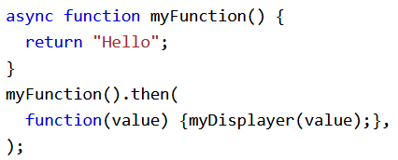
Async Syntax
We can then use that promise with .then()
Our example is only displaying text on a webpage so there is no chance of failure, meaning we do not need a failure case

Slide 29

Await Syntax
The await keyword makes a function wait for a promise to resolve before the function can continue
await can only be used inside of a promise

Slide 30
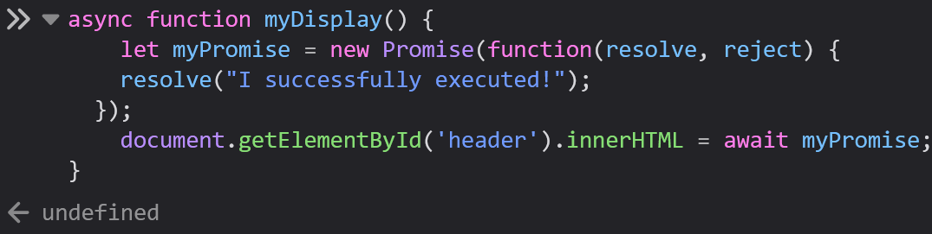

Await Example
This example will display the text “I successfully executed!” as soon as the promise resolves
The await keyword stops us from displaying undefined in the case that the promise takes a while to execute

Slide 31
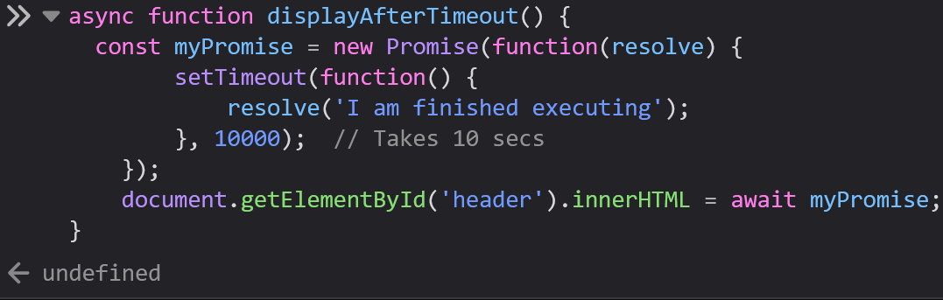
Example
Here we use async/await to figure out to ensure that we are actually displaying the result of the promise

Slide 32
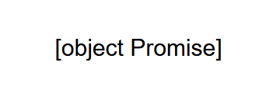
Example
If we tried to do that without using async/await, here is what the output would look like:
This happens because JavaScript reads the display line before the Promise has reached its resolution
This is why await is so handy

Slide 33
For Today:
Module 14 Exercises
Previous Exercises
Atometric

